Slide 1
Small Business Online Ordering & Inventory Management System
Milestone 1 – Video presentation
Group: [Group 4 - 18558]
Members: Gabriel Morales Zayas, Eric Daugherty, Andres Duran Araujo, Alejandro Gonzales jimenez

Slide 2

Business Overview – Sunrise Café (Fictional)
Family-owned local restaurant with strong walk-in base.
Currently accepts walk-in and phone orders only (no online presence).
Inventory tracked manually via notes/spreadsheets.
Goal: Modernize operations and reach online customers.

Slide 3

The Problem
No online presence → limited customer reach and missed revenue.
Phone orders cause delays and mistakes during peak hours.
Manual inventory → stockouts, overstock, and waste.
Overall lower revenue and customer satisfaction.

Slide 4
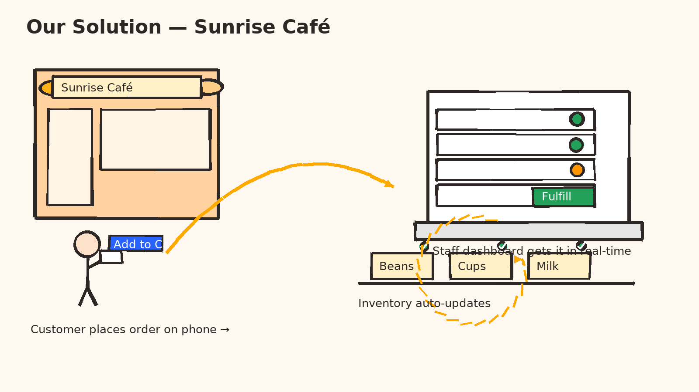
Our Solution
Customer-facing website for browsing menu and placing orders.
Staff dashboard to view/manage orders in real time.
Automatic inventory updates triggered by orders/admin changes.
Saves time, reduces mistakes, and increases sales.

Slide 5



Tools & Project Management
Repository: GitHub – code, docs, presentations.
Slides & Visuals: PowerPoint/Google Slides.
Tech Stack: Visual Studio Code.
Gantt Chart: Semester plan with milestones.

Slide 6
Roles & Tasks for Next Milestone
Member | Role | Next Milestone Tasks
[ANDRES DURAN ARAUJO] [ERIC DAUGHERTY] | Frontend Developer | Creation of the website. Design of the front.
[ALEJANDRO GONZALES] | Backend Developer | Refining the Database, and gathering information.
[GABRIEL MORALES] | IT/Project Manager & QA | Create repo structure; task board; smoke test checklist.

Slide 7
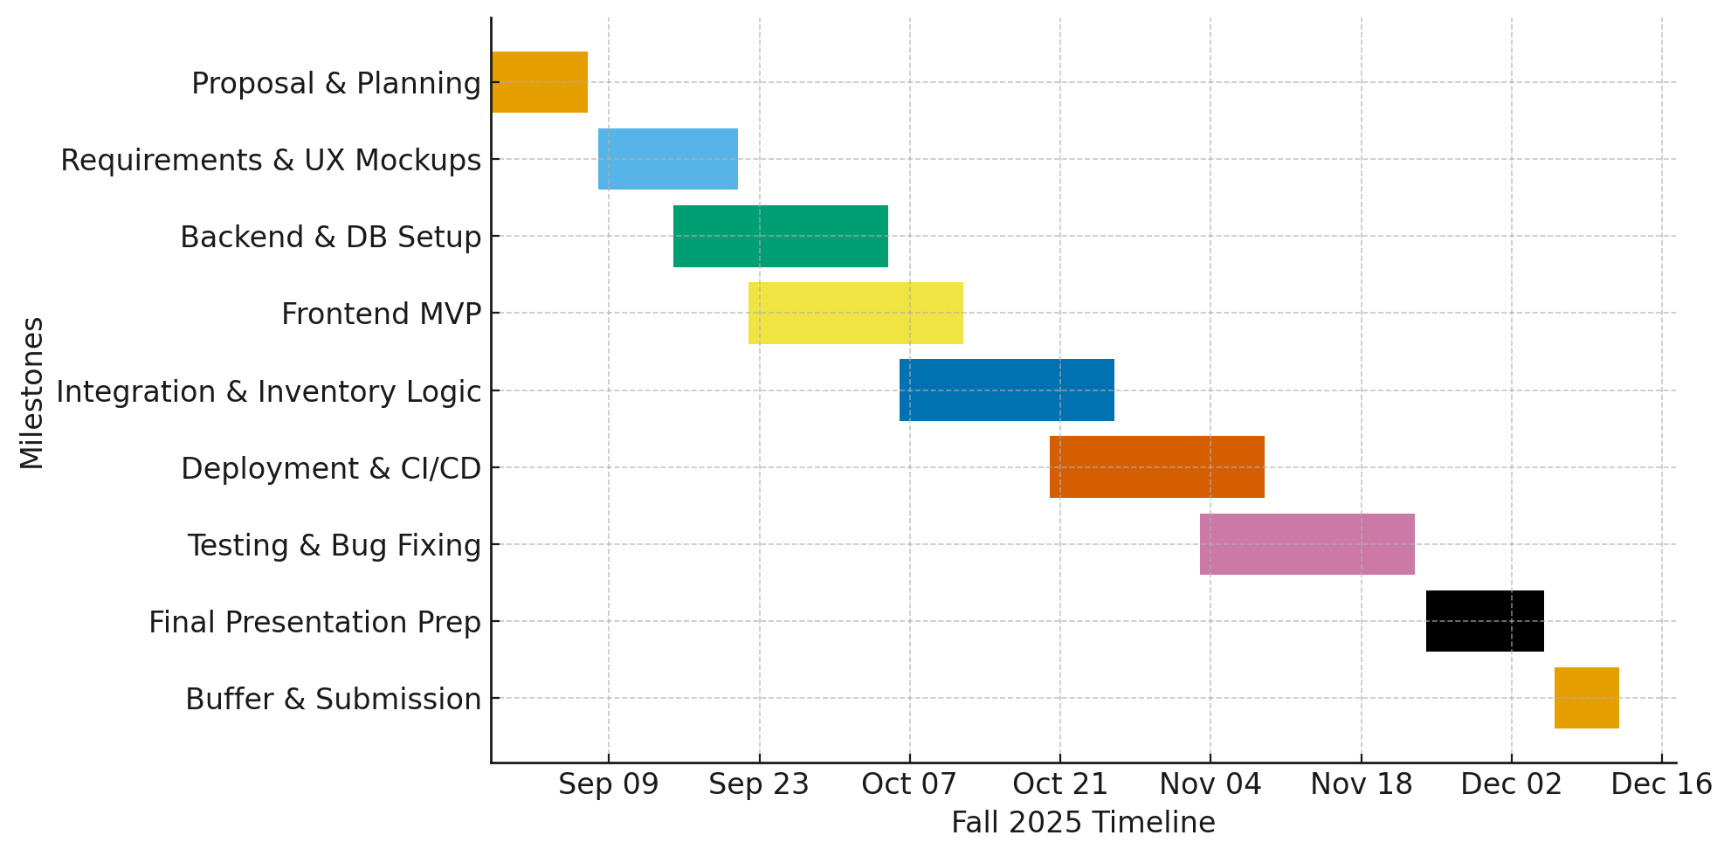
Gantt Chart – Semester Plan

Slide 8
Repository Github
GitHub Repository: AndresDuran27/Group4-18558: Repository For the Group 4 on the SMALL BUSINESS ONLINE ORDERING & INVETORY MANAGEMENT SYSTEM
This includes YouTube Link to the presentation, plus the document of our task and role in this project.

